Slide 1
CS6143 – Artificial Intelligence and Machine Learning Project 2023/2024 Zero-shot Recommendation System using open-source LLMs for Airline Industry and Optimization techniques in Retrieval Augmented Generation (RAG) Sajin Mohamed Pallikkathodi Erathali MSc. Artificial Intelligence and Machine Learning Student ID : 23037601

Slide 2
Motivation
Passenger Dissatisfaction: Airline issues like cancellations, delays, or seating problems often lead to dissatisfaction. Airlines typically offer coupons, but this one-size-fits-all approach may not satisfy everyone.
Impact of Negative Reviews: Dissatisfied passengers often voice their frustrations on platforms like TrustPilot, AirlineReviews potentially damaging the airline's reputation.
Leveraging Sentiment Analysis: By analyzing these reviews, we can gauge passenger frustration and recommend tailored solutions to enhance customer loyalty.
Enhancing RAG with Knowledge Graphs: Investigate the improvement in Zero-shot recommender when integrated with Knowledge Graphs (KG).
Cost-effective Optimization: Explore non-traditional optimization methods (fine-tuning embeddings, multi-query retrievals, cross-encoder re-ranking, token optimization) as alternatives to expensive fine-tuning of large language models (LLMs).

Slide 3
Research Questions
Model Suitability: Which large language model, Mistral or Llama2, is best suited for zero-shot recommendation in the airline industry, focusing on alternatives based on travel history and customer ratings?
Knowledge Graph Impact: How much improvement in recommendation accuracy (e.g., precision, recall) can be achieved by integrating Knowledge Graphs into the architecture?
RAG Optimization: What are the most effective methods to enhance Retrieval-Augmented Generation (RAG), such as fine-tuning embeddings, multi-query expansion, document re-ranking, and token optimization?

Slide 4
Dataset for Zero-shot recommender with KG and Without KG
The extracted dataset from Kaggle is modified for creating the Zero-shot recommender to include the following:
Booking_ID – The booking Id of the passenger
Passenger_Name – The name of the passenger
Review – The review obtained from the Kaggle Dataset concerning both positive and negative reviews
Membership_level – The membership level of the passenger, here 4 membership levels are considered namely, Bronze, Silver, Gold, Platinum, where priority is given in order.
5. Rating – The rating provided by the passenger for the journey undertaken.
The user details are created by using Faker library to include data such as :
Booking_ID, Passenger_Name, Passenger_ID, Flight_Number, Departure_Airport, Arrival_Airport, Departure_Date_and_Time, Arrival_Date_and_Time, Seat_Number, Class, Booking_Date Contact_Information, Payment_Status, Price, Loyalty_Program_Level.

Slide 5
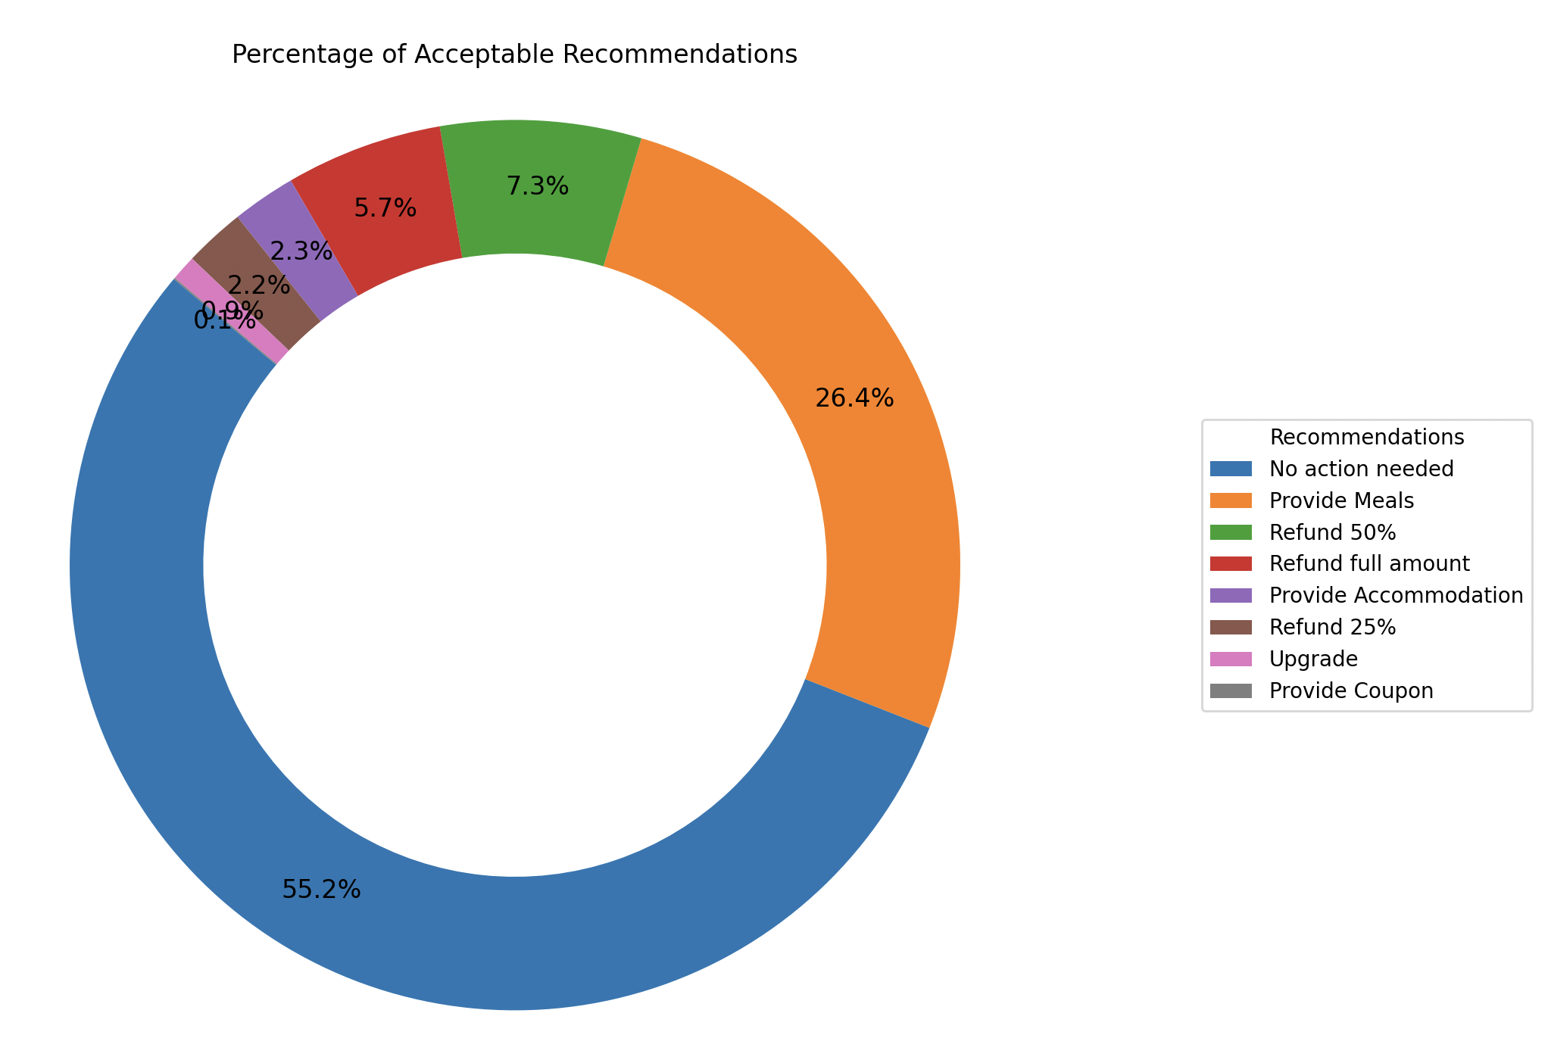
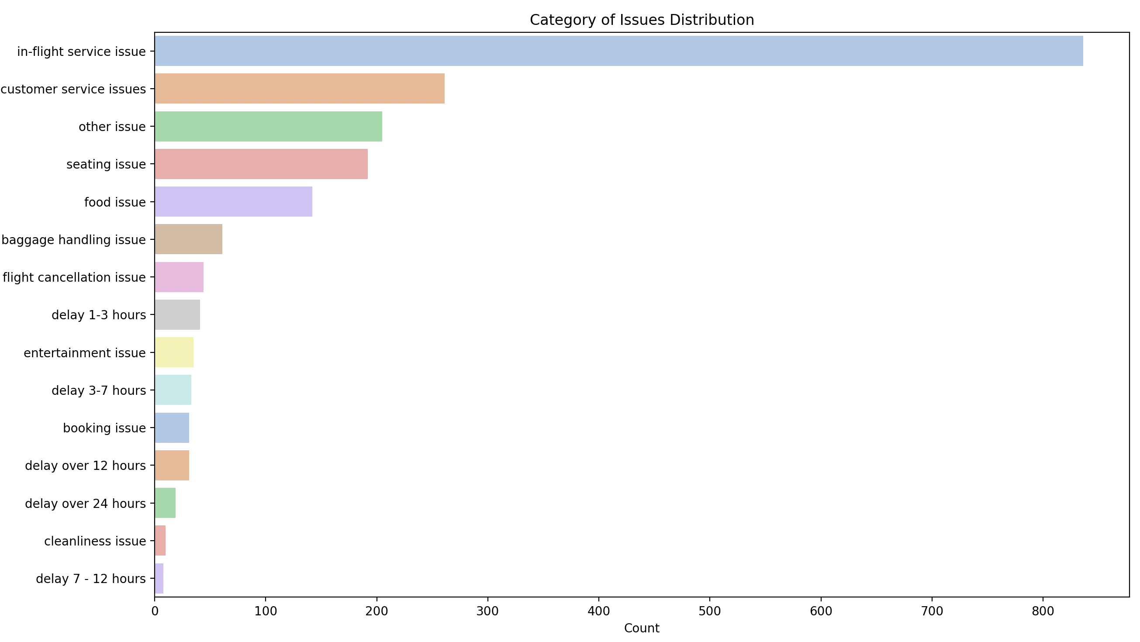
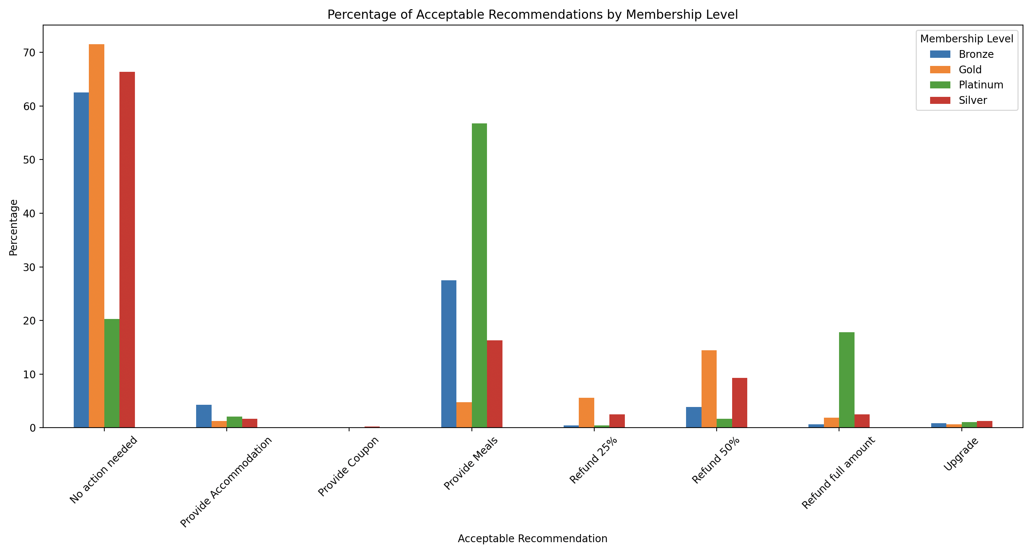
Dataset for Zero-shot recommender with KG and Without KG

Slide 6
Dataset for RAG Optimization and token optimization
The dataset is scraped from Wikipedia using the Wikipedia-api with category of articles such as:
"Sherlock_Holmes", "Arthur_Conan_Doyle", "A_Scandal_in_Bohemia", "The_Adventures_of_Sherlock_Holmes", "A_Study_in_Scarlet", "The_Sign_of_the_Four", "The_Memoirs_of_Sherlock_Holmes", "The_Hound_of_the_Baskervilles", "The_Return_of_Sherlock_Holmes", "The_Valley_of_Fear", "His_Last_Bow", "The_Case-Book_of_Sherlock_Holmes", "Canon_of_Sherlock_Holmes", "Dr._Watson", "221B_Baker_Street", "Mrs._Hudson", "Professor_Moriarty", "The_Strand_Magazine".
This was done in an attempt to understand how the fine-tuned embedding models investigated in the study would embed seemingly related data from different sources that are related.

Slide 7
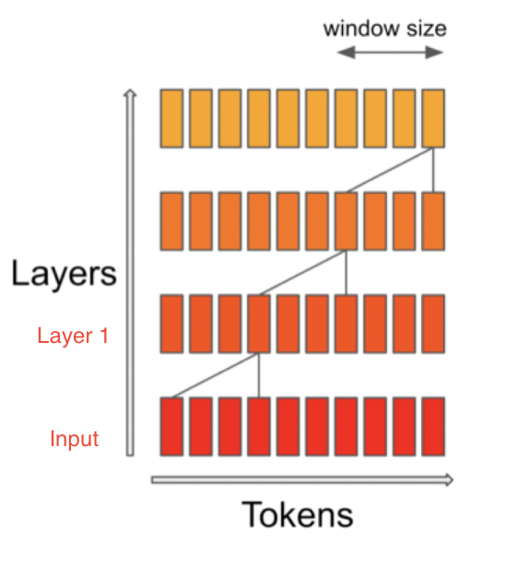
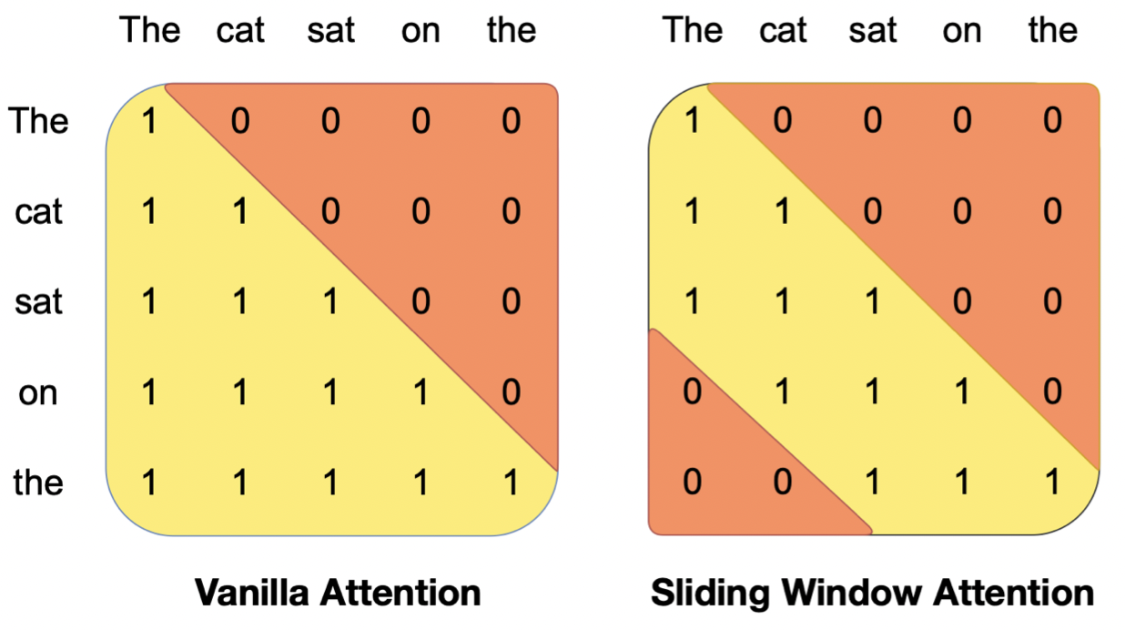
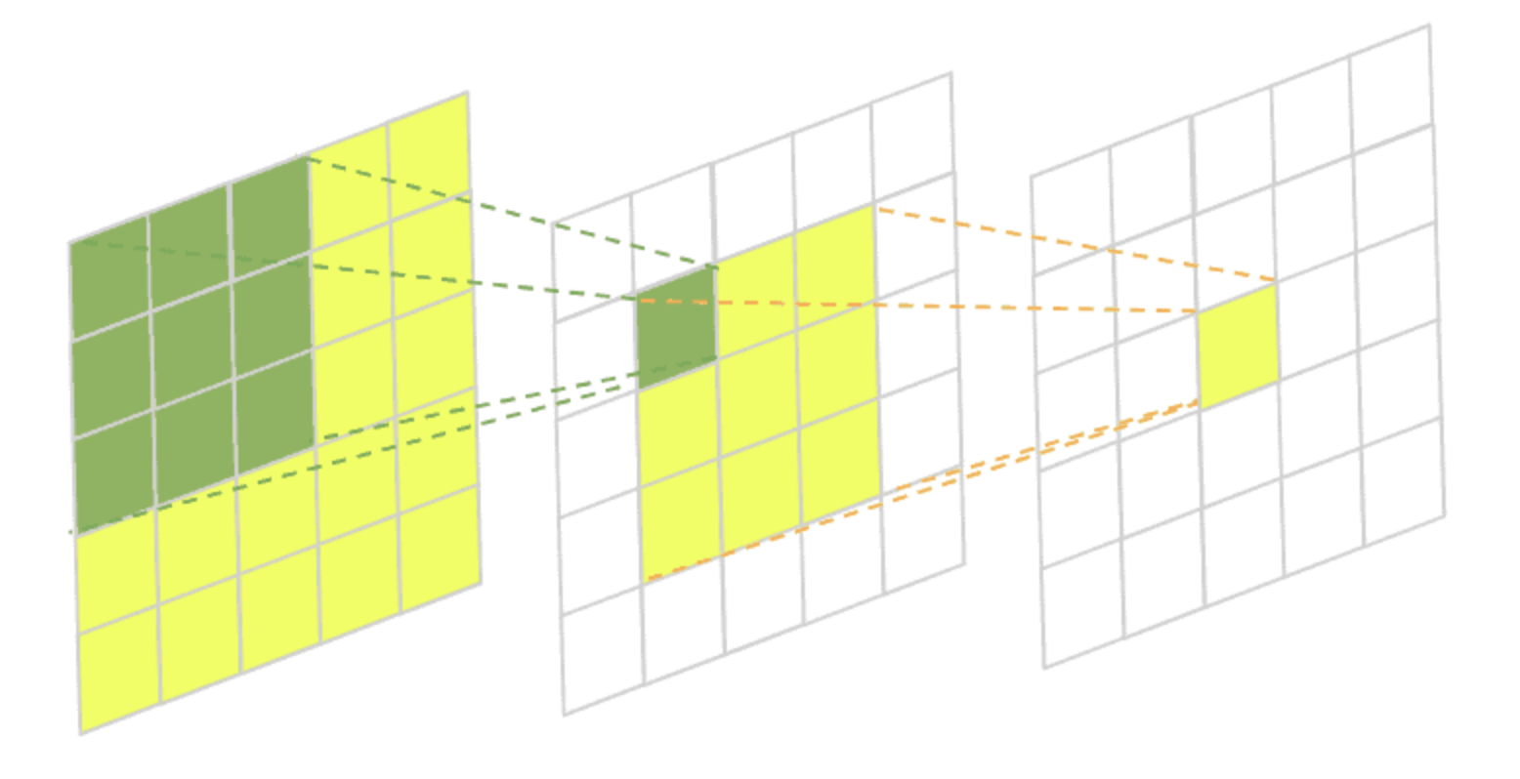
Mistral (7B) Working
The first 4 tokens from the input is passed to the 4th token of the Layer 1 which passed to the 7th token of layer 2. Even though the 1st token is not directly related to the 7th token, its related via the layer 1 which contains the information about the 1st token. (Jiang et al. 2023).
Receptive Fields in CNN

Slide 8
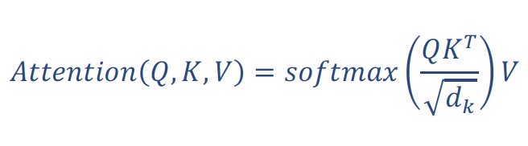
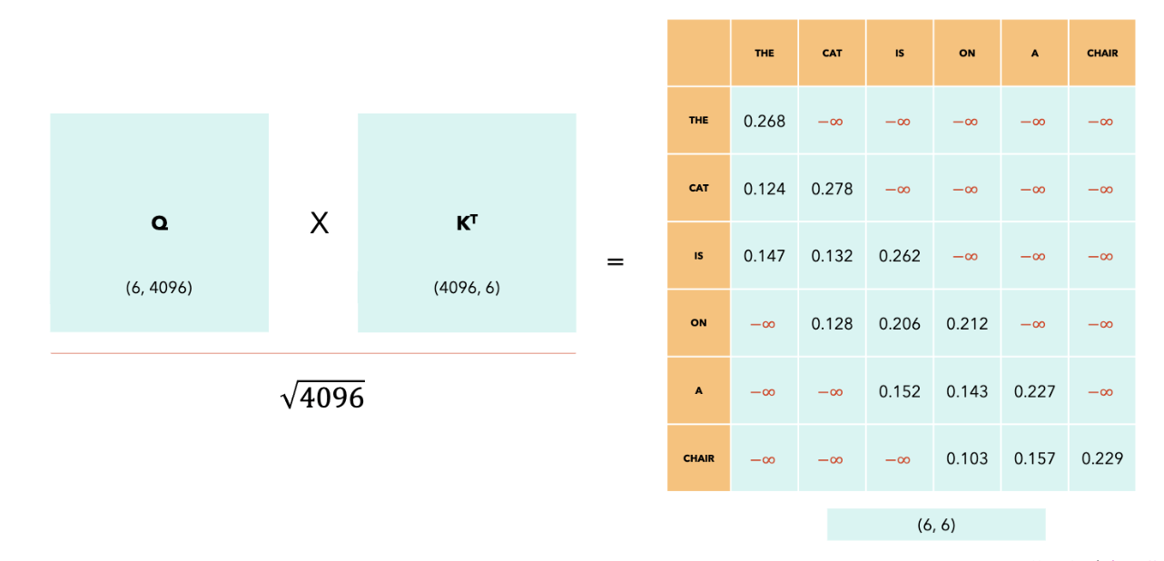
Sliding Window Attention

Slide 9
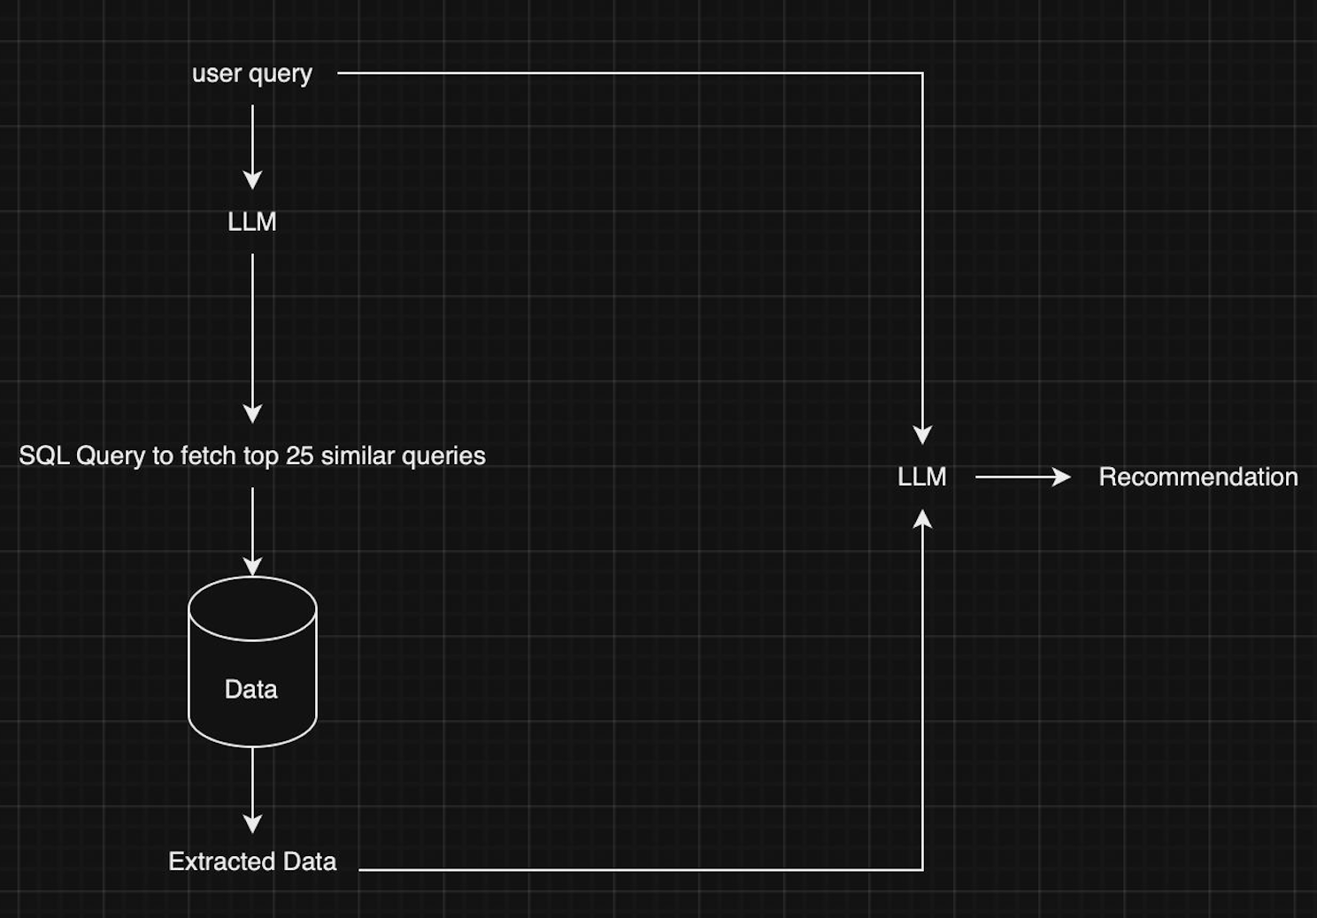
Methodology
Simple Recommender System
Architecture of a simple recommender system using LLM.

Slide 10
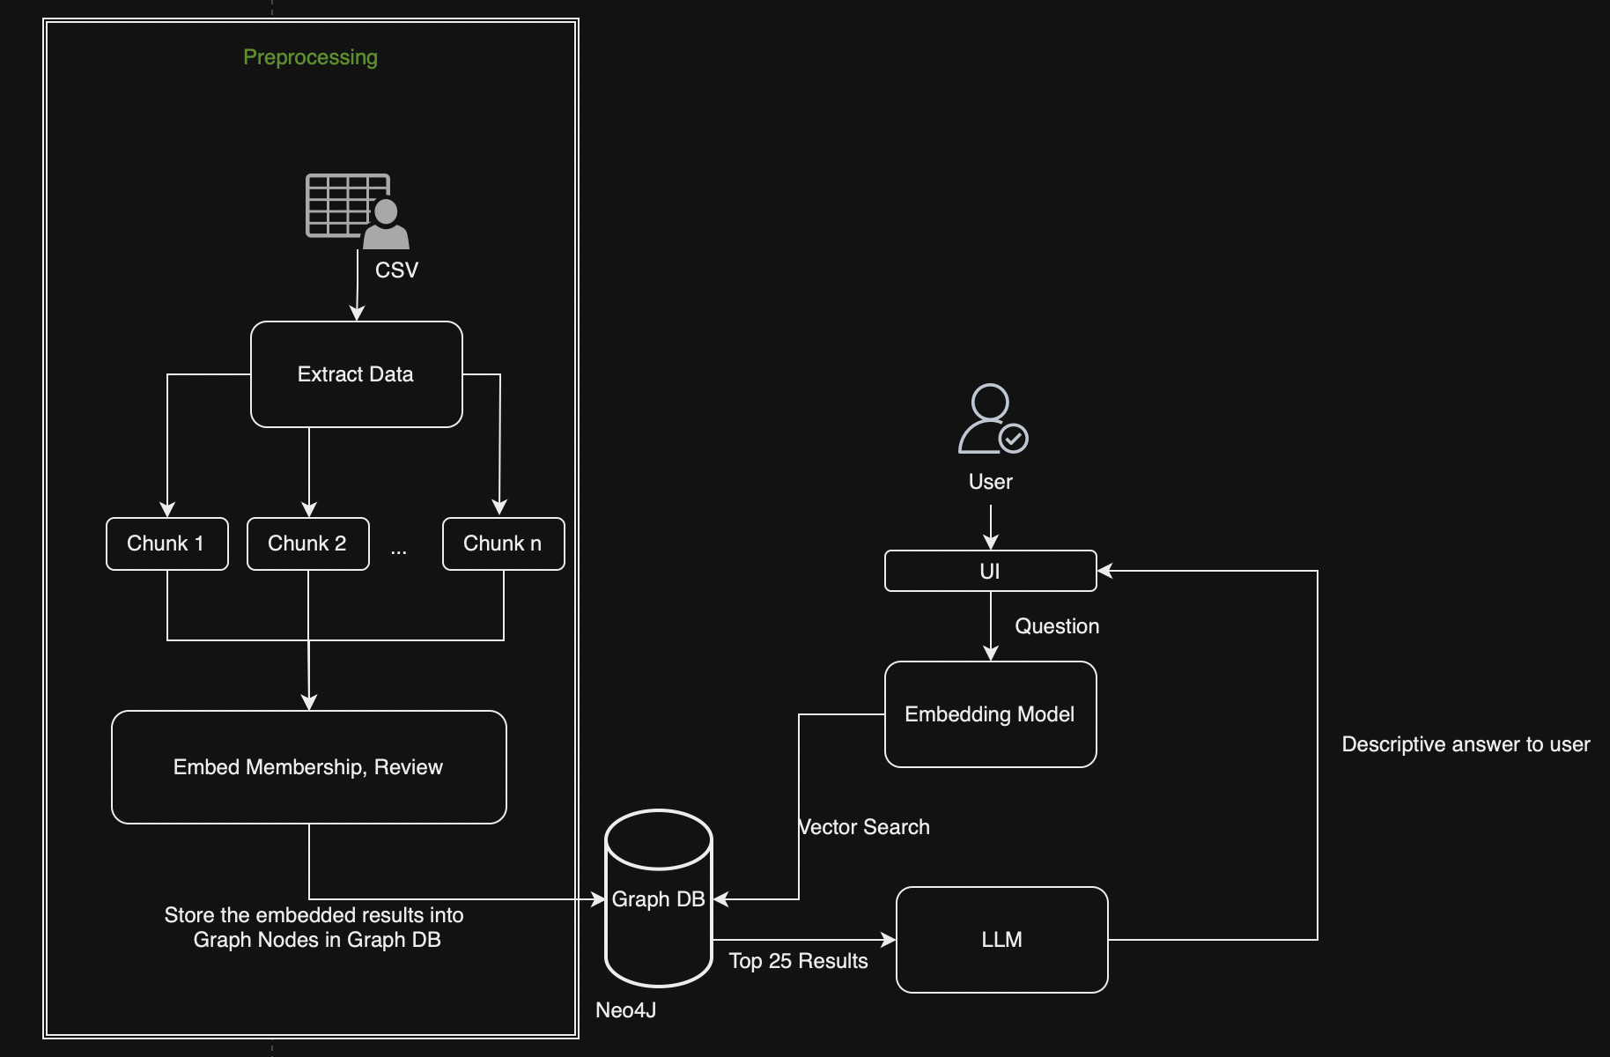
Recommender System with KG
Recomender with KG
Preprocessing
Extract the data from the CSV that contains all the fields described in Dataset.
Split the data into smaller chunks for efficient memory management
Embed the data obtained using a Sentence Transformer (sentence-transformers/all-MiniLM-L6-v2) and store the result in the Graph Database (Neo4J)
Recommender with Knowledge Graph (KG).
Notes:
Input Passenger Concern: Employee submits passenger concern and Booking ID via UI.
Retrieve Passenger Data: System fetches passenger's membership level from the Knowledge Graph (KG) using the Booking ID and classifies the issue via LLM.
Generate Embeddings: KG stores embeddings for combined membership, review, and category using a Sentence Transformer. These embeddings are indexed in the KG.
Query Embedding: System embeds the user query, combined with membership level and issue category, to create a vector for comparison.
Similarity Matching: System identifies the top 25 records using cosine similarity between the query and KG dataset.
Generate Recommendations: Top 25 records, including recommendation history, are fed into LLM to produce tailored top 3 recommendations with explanations.

Slide 11
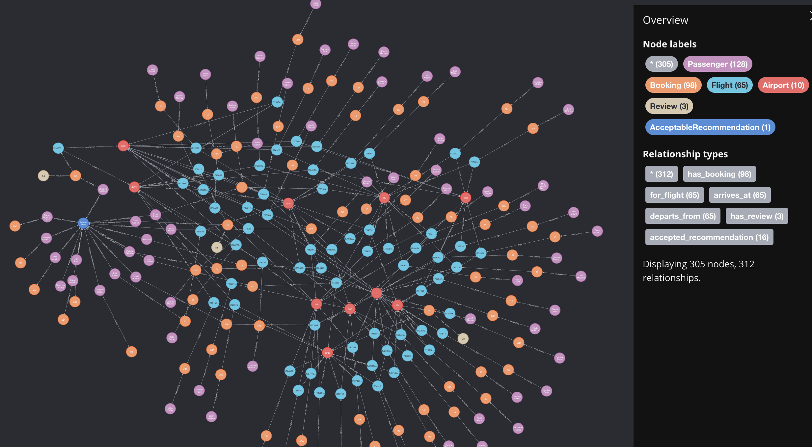
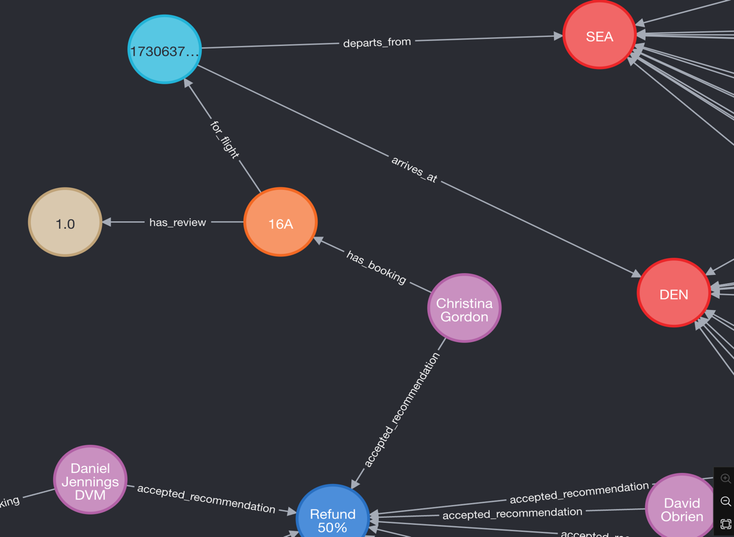
Resultant KG
A sub-section of the Knowledge Graph (KG).
An Enlarged view of the relationships between the nodes in the KG.

Slide 12
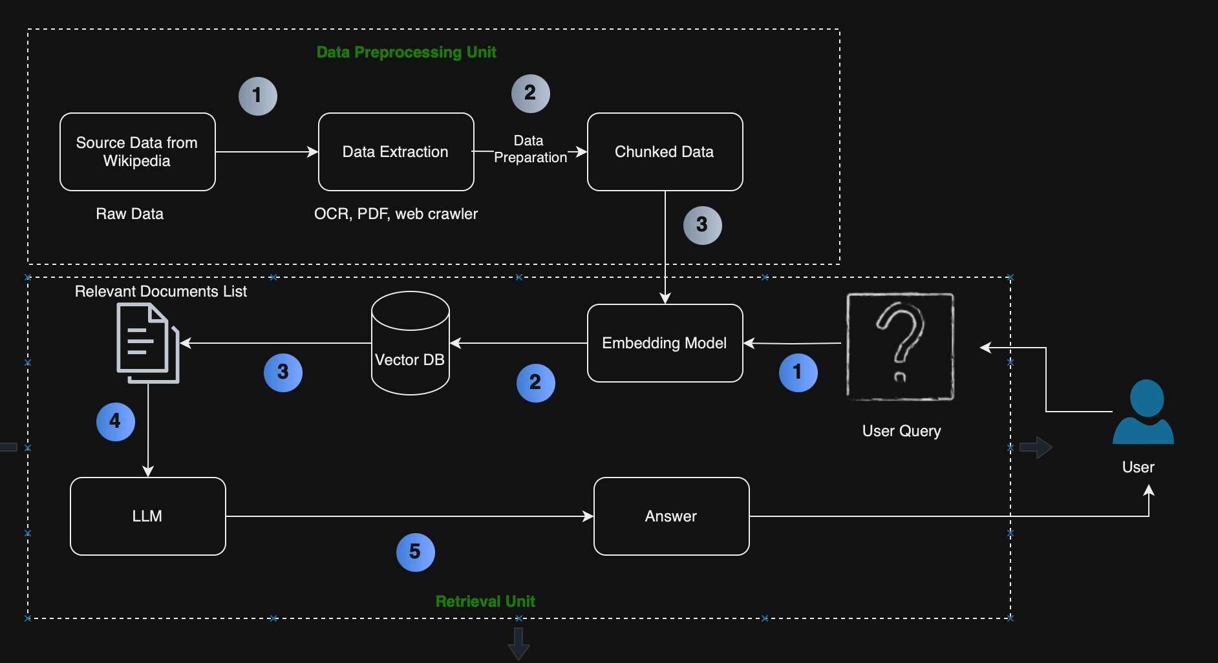
Retrieval Augmented Generation (RAG)
RAG Pipeline showing the different steps in the retrieval augmented generation and the way the result is returned to the user provided a query from the user is consumed by the system [source: (Özker 2024)].

Slide 13
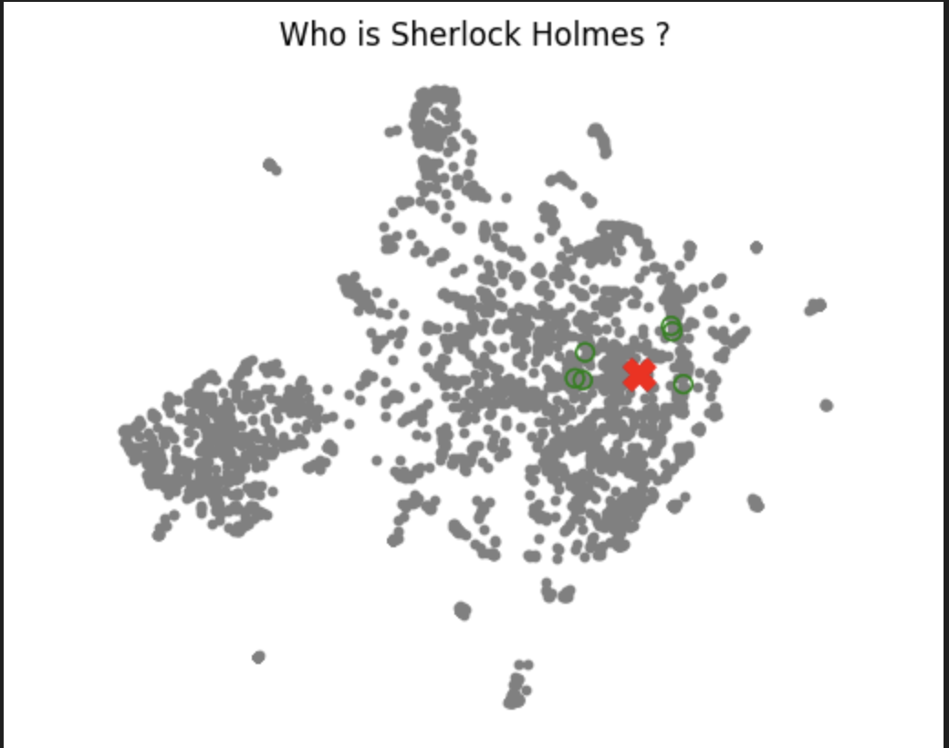
RAG Optimization – Fine-tuned Embeddings
The 3 embedding models considered here are :
Sentence-transformers/all-MiniLM-L6-v2
BAAI/bge-small-en-v1.5
Int/float/multilingual-E5-small
The BAAI/bge-small-en-v1.5 embeddings of the Train Dataset projected onto a 2-dimensional vector space with the query (red X) and the retrieved documents (green circle) as highlighted.

Slide 14
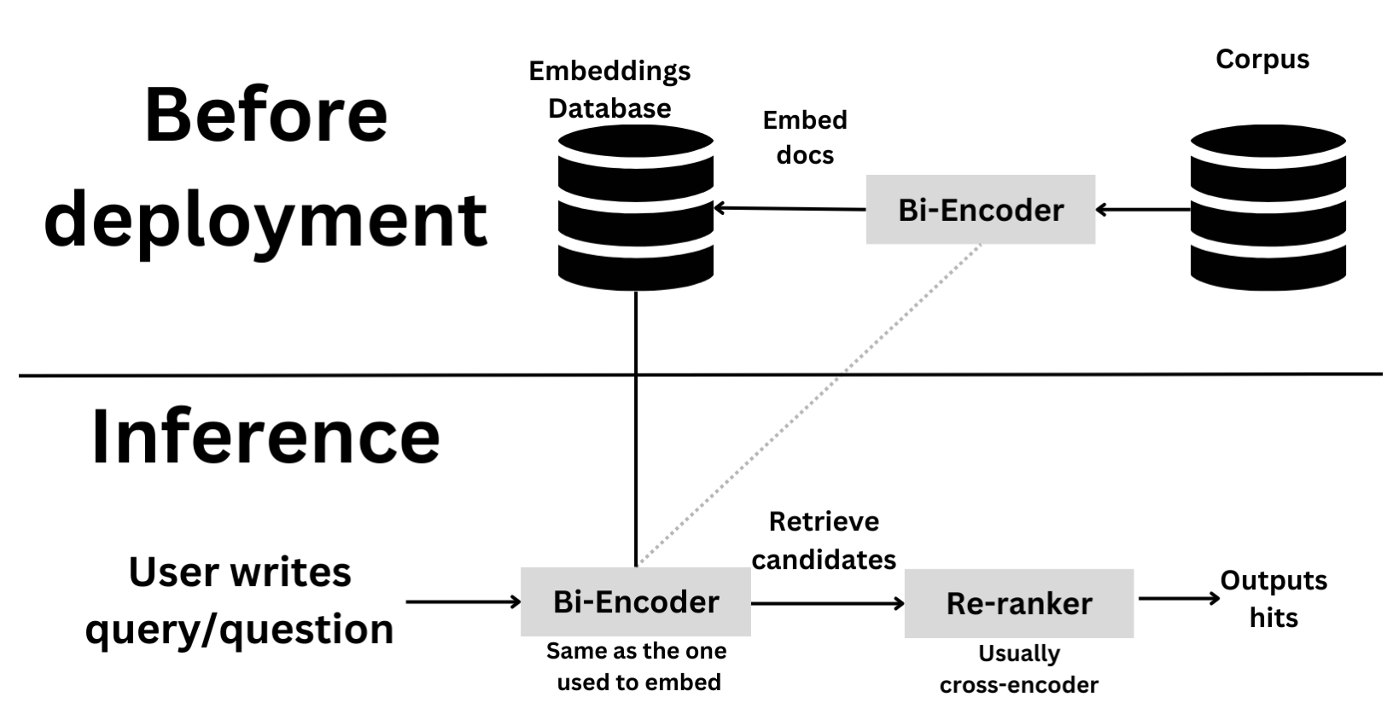
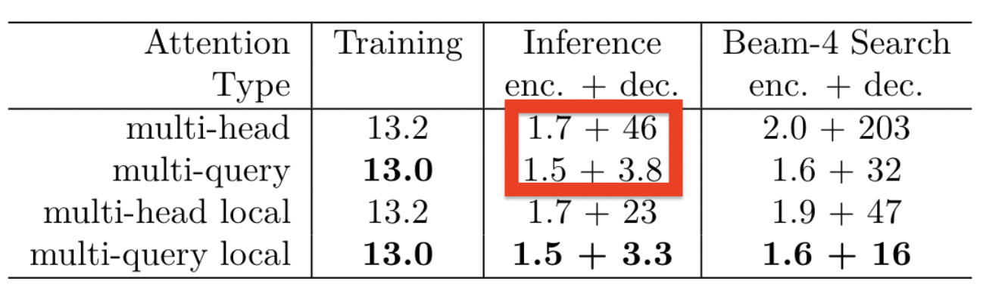
RAG Optimization – Cross-encoder Re-ranking with Multi-Query Expansion
Prompt For LLM Llama 3
“You are an AI language model assistant. Your task is to generate five different versions of the given user question to retrieve relevant documents from a vector database. By generating multiple perspectives on the user question, your goal is to help the user overcome some of the limitations of the distance-based similarity search. Provide these alternative questions separated by newlines. Only provide the query, no numbering. Original question: {question}”
Illustration of how bi-encoders and cross-encoders work together to improve result retrieval
[source: Osanseviero, O., 2023].
The output of the LLM for a question like “Who is Sherlock Holmes?” would be
1. “Who was the famous detective created by Arthur Conan Doyle?"
2. "Can you find information about the character Sherlock Holmes from the stories of Sir Arthur Conan Doyle?"
3. "Identify the protagonist of the Arthur Conan Doyle's detective stories."
4. "Provide details on the character known as Sherlock Holmes in the works of Sir Arthur Conan Doyle."
5. "Describe the main character in the detective series written by Sir Arthur Conan Doyle, focusing on his name."
Improvement in Inference time for multi-query attention when compared to multi-head attention
[source: (Shazeer 2019)]

Slide 15
RAG Optimization - Token Optimization
1. Byte-Pair Encoding (BPE)
2. Wordpiece
3. Sentencepiece
4. Latent Semantic Analysis (LSA)
Notes:
Introduced by: Gage (1994); Adapted to NLP by Sennrich et al. (2016).
Key Features:
Merges frequent character pairs to form subwords.
Handles Out-of-Vocabulary (OOV) words effectively.
Commonly used in Neural Machine Translation (NMT).
Initialize: Start with each character as an individual token.
Pair Frequency: Identify the most frequent pair of adjacent tokens.
Merge: Merge the frequent pair into a new token.
Repeat: Continue until the desired vocabulary size is reached

Slide 16
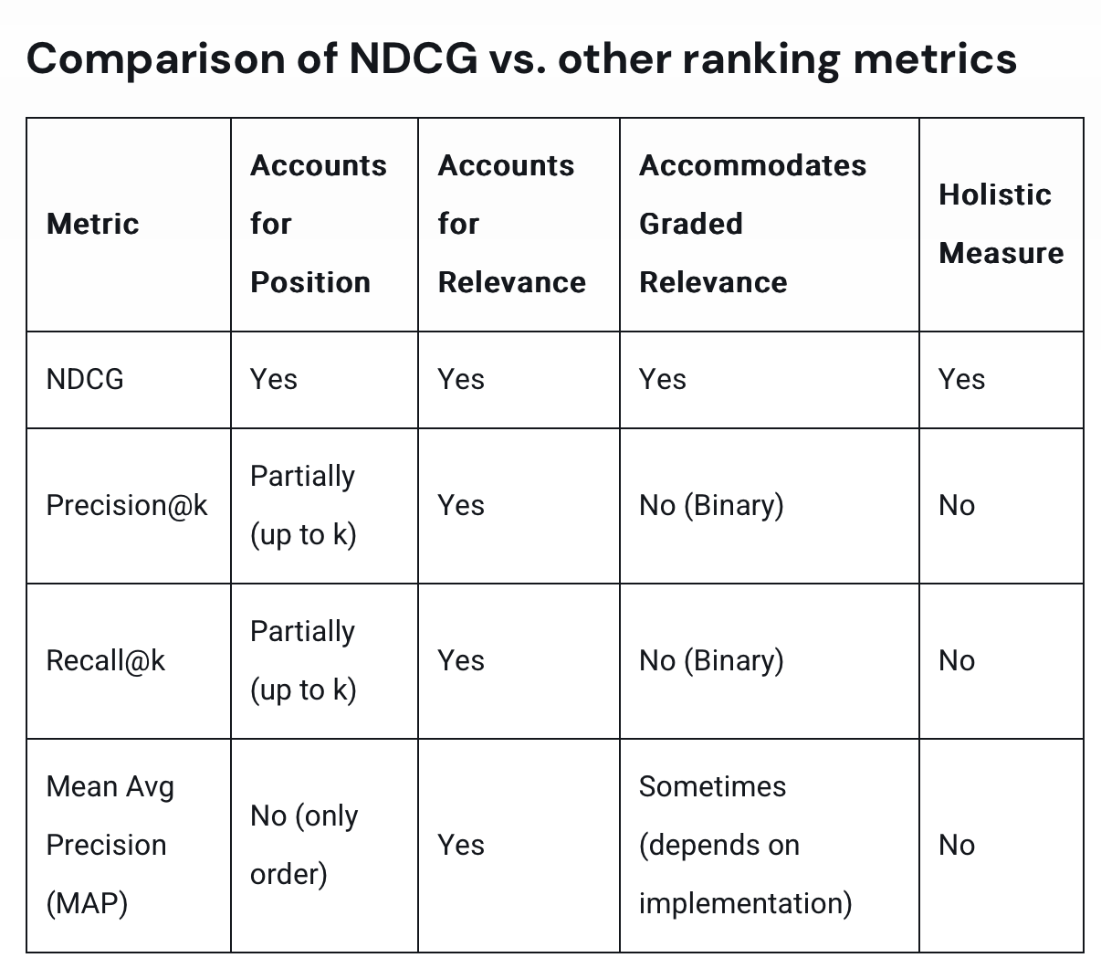
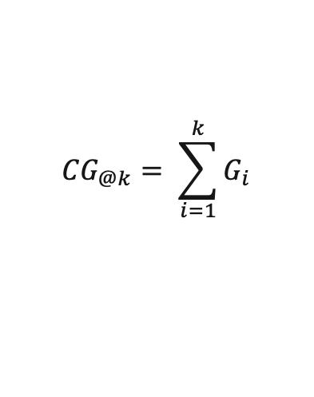
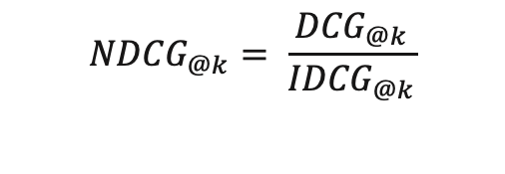
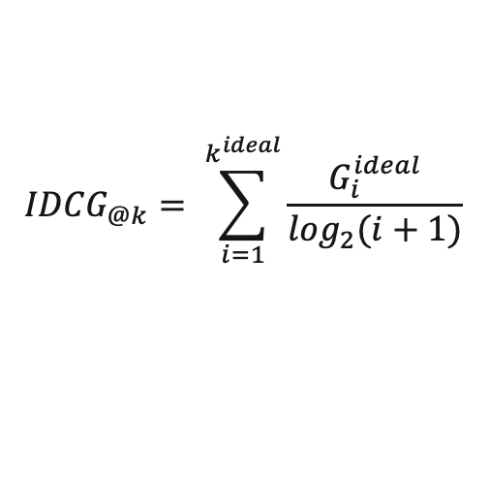
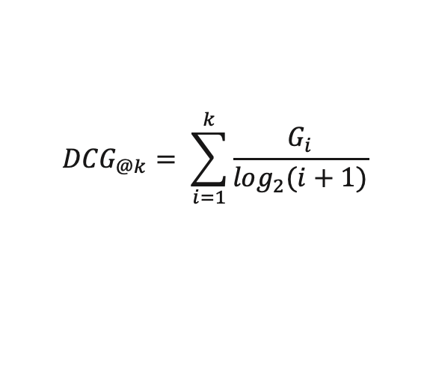
RAGAS and NDCG
Limitations of ROUGE and BLEU: While effective for n-gram similarity in tasks like translation and summarization, ROUGE and BLEU may not fully capture the relevance and accuracy needed for evaluating complex tasks like Retrieval-Augmented Generation (RAG).
RAGAS Metrics Overview (Es et al., 2023; 'Metrics | Ragas', 2024):
Faithfulness
Answer Relevance
Context Precision
Context Recall
Normalized Discounted Cumulative Gain (NDCG)
$${CG}_{@k}= \sum_{i=1}^{k}{G_{i}}$$
$${DCG}_{@k}= \sum_{i=1}^{k}{\frac{G_{i}}{\log_{2}(i+1)}}$$
$${IDCG}_{@k}= \sum_{i=1}^{k^{ideal}}{\frac{G_{i}^{ideal}}{\log_{2}(i+1)}}$$
$${NDCG}_{@k}= \frac{{DCG}_{@k}}{{IDCG}_{@k}}$$

Slide 17
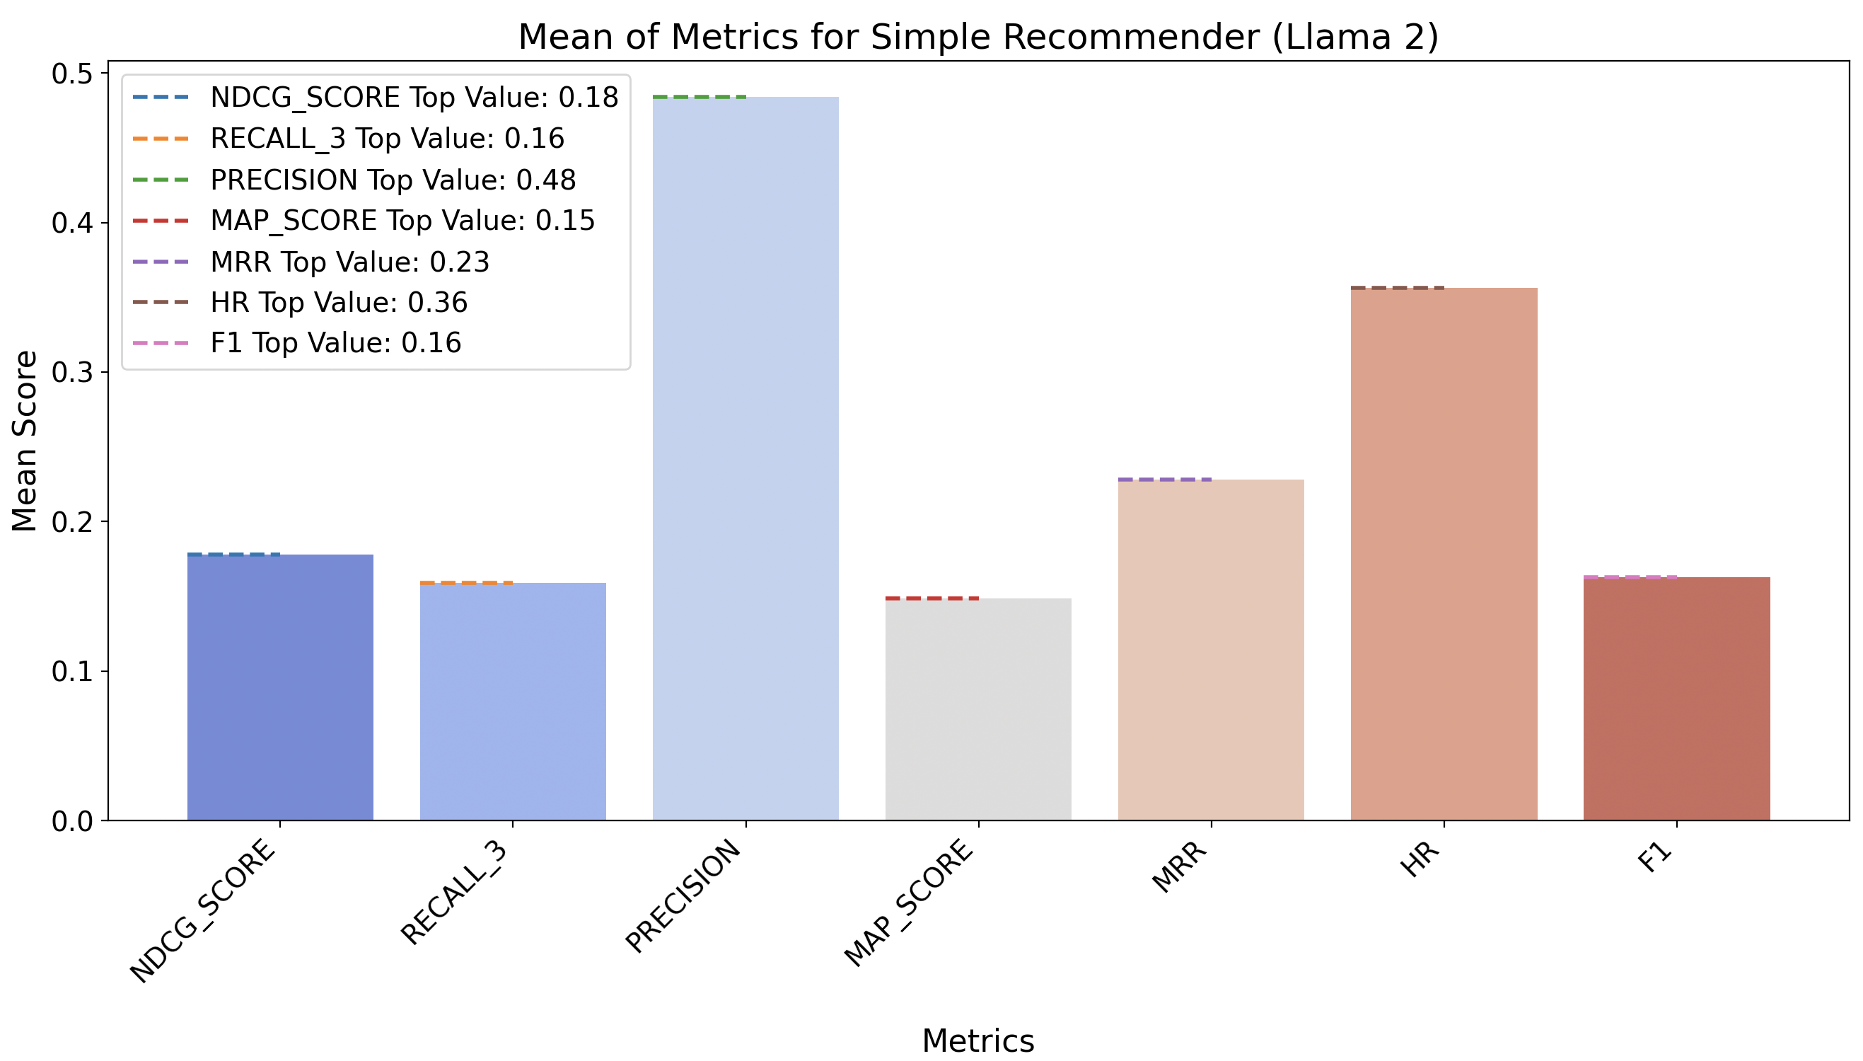
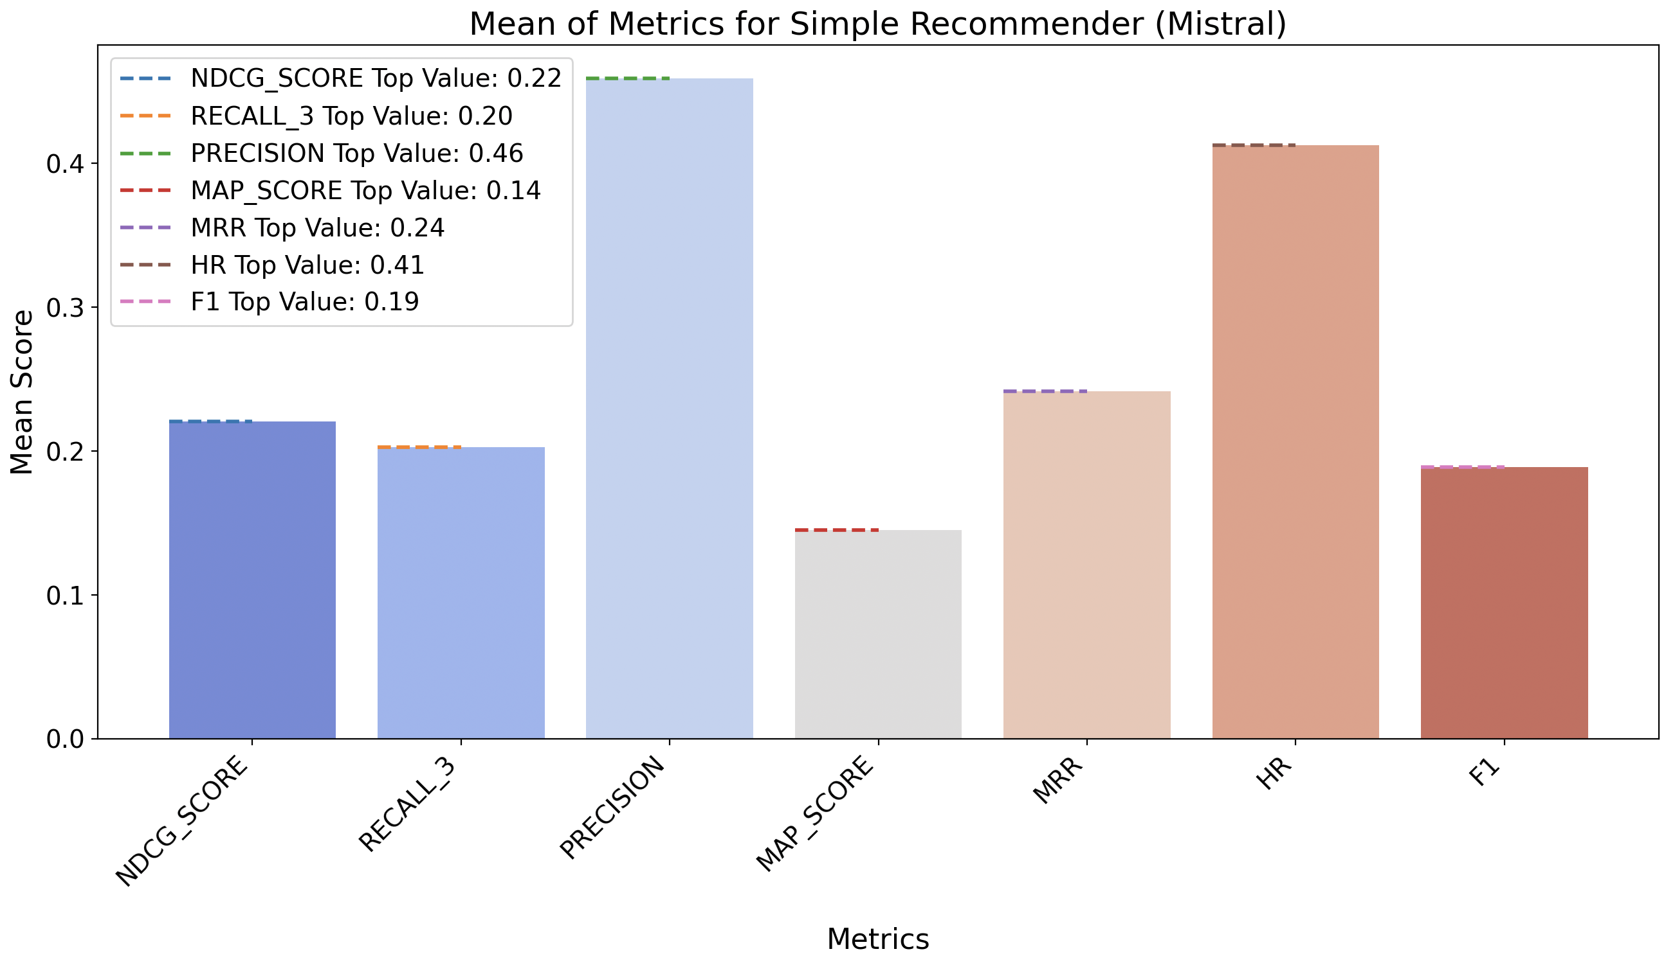
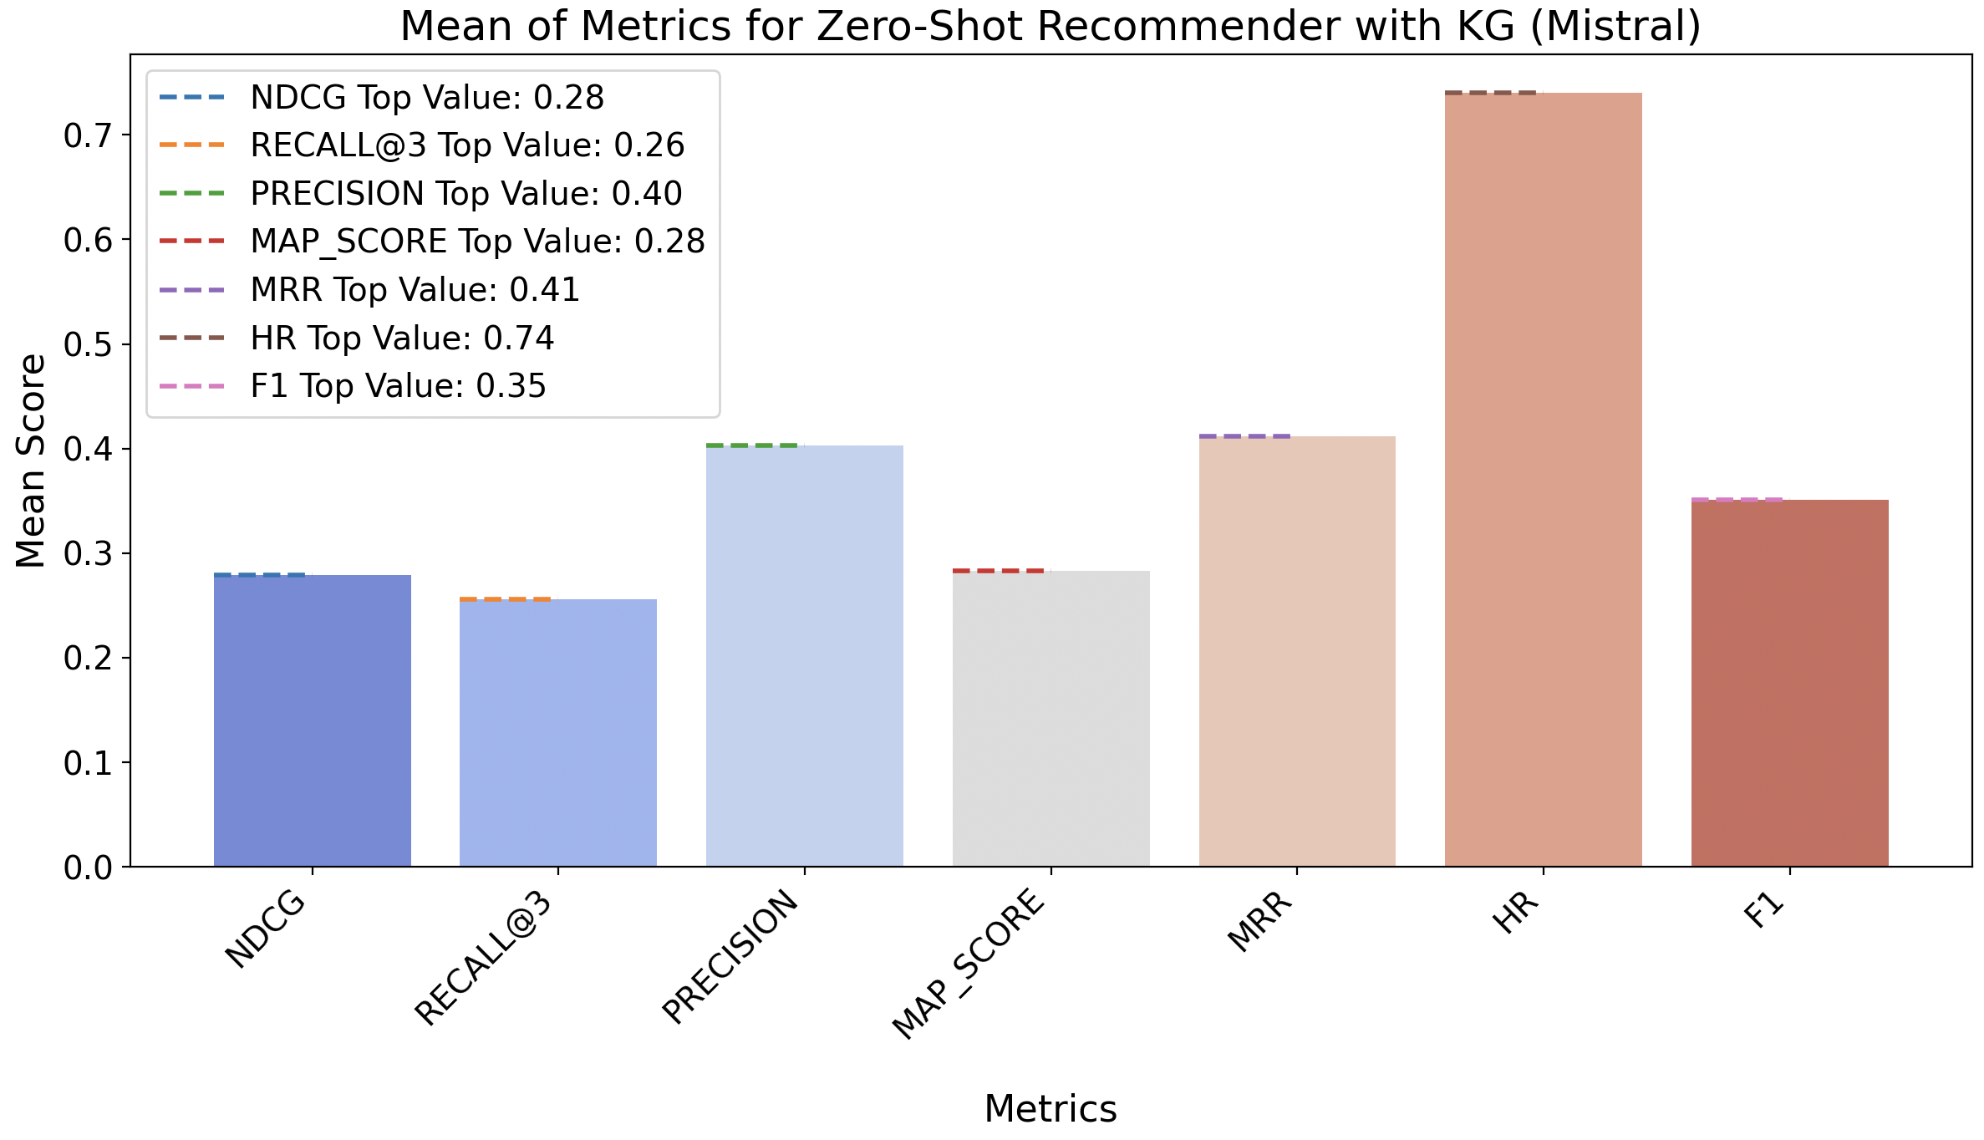
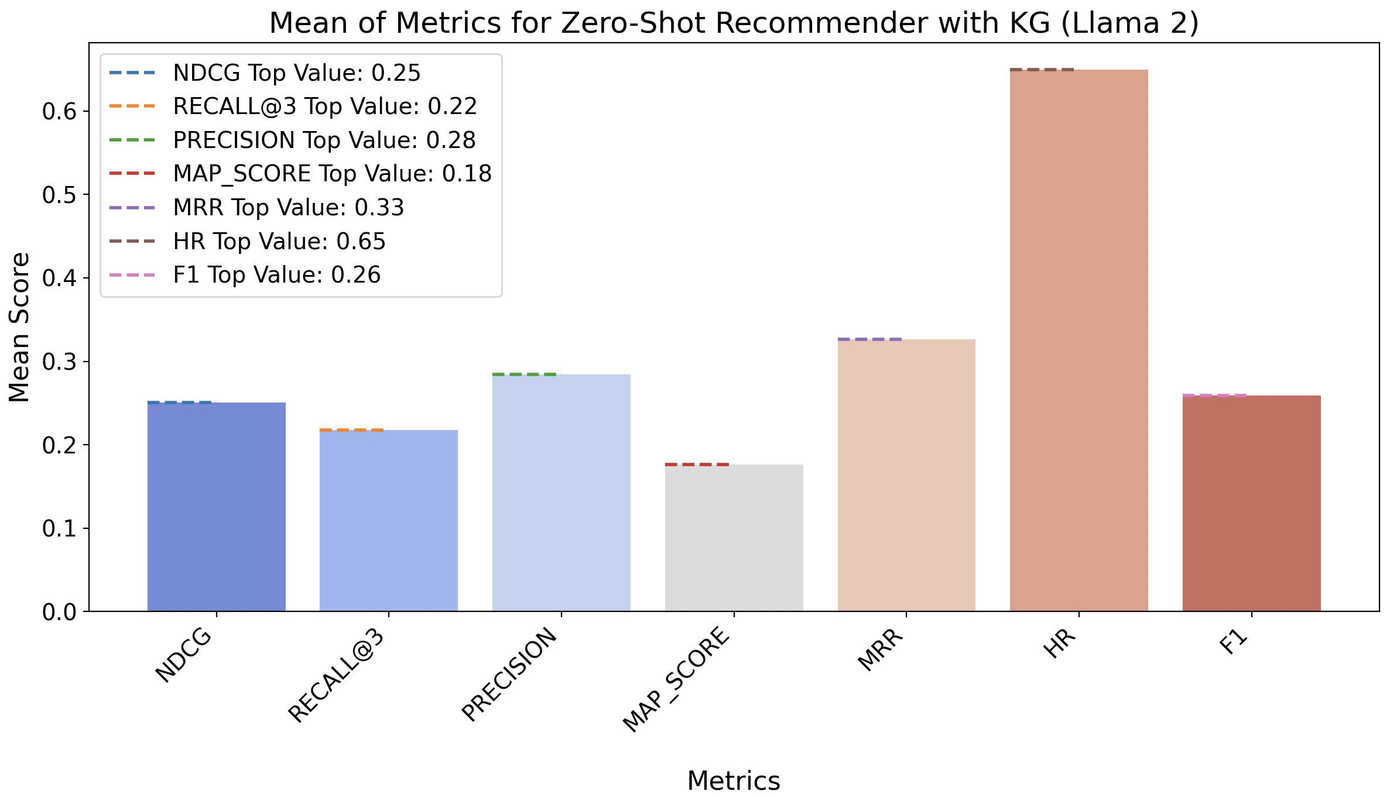
Results
Llama 2
Mistral

Slide 18
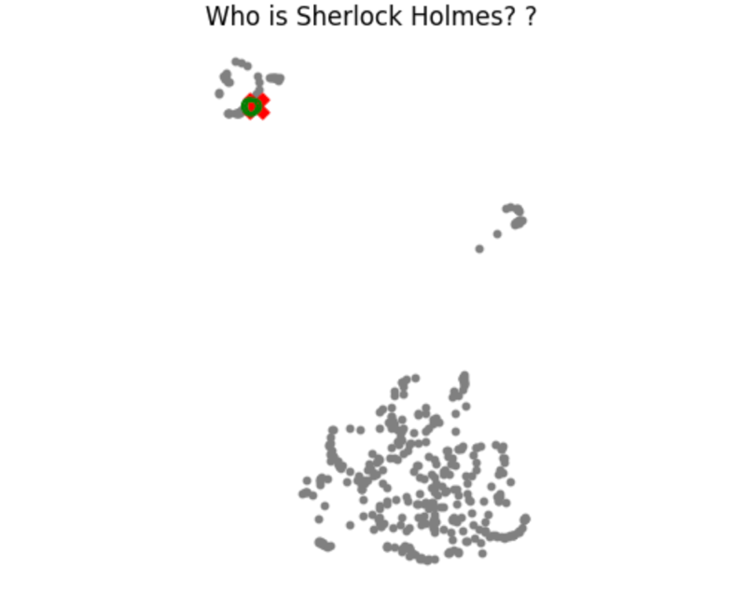
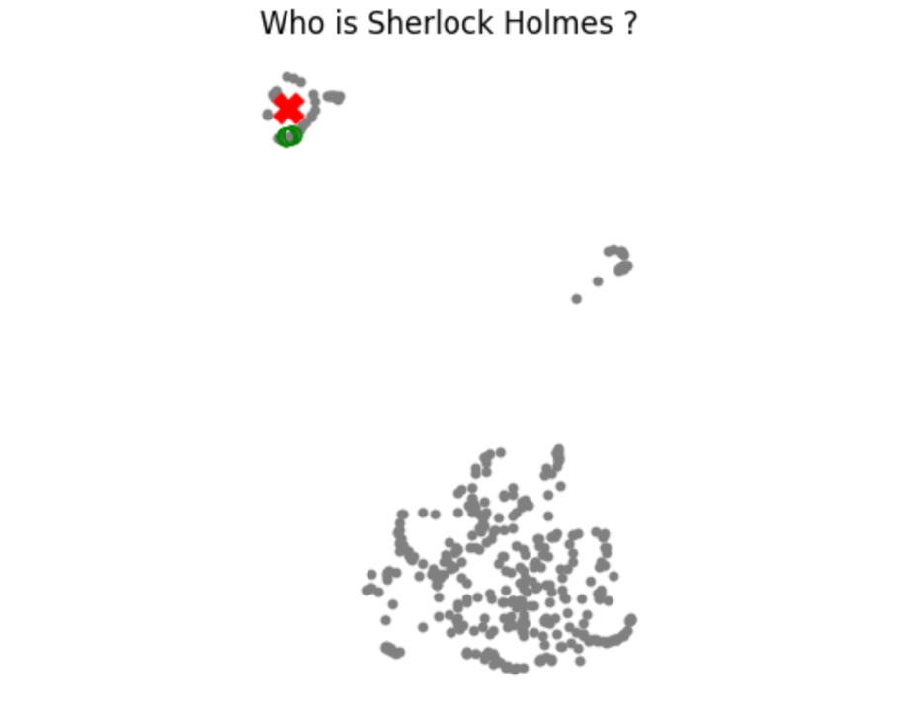

Results - RAG Optimization – Fine-tuned Embeddings
Plotting “Who is Sherlock Holmes?” vector embedding
on Train Data with Sentence-transformers/all-MiniLM-L6-v2
The vector embeddings for the fine-tuned BAAI/bge-small-en-v1.5 model, depicting
the question "Who is Sherlock Holmes?" on a 2-dimensional plane.
Sentence-transformers/all-MiniLM-L6-v2
BAAI/bge-small-en-v1.5
Int/float/multilingual-E5-small
The pictorial representation of the vectors represented on 2-dimensional plane for the fine-tuned int/float/multilingual-E5-small.

Slide 19
Results – Cross Encoder Evaluation with Multi-query Expansion
 | context_precision | faithfulness | answer_relevancy | context_recall
Without multi-query expansion | 0.15079365 | 0.42357456 | 0.5287953 | 0.86728088
multi-query expansion | 0.15873016 | 0.44818182 | 0.53343058 | 0.87026892
RAGAS metrics with cross-encoder re-ranking and without multi-query expansion and int/float/multilingual-E5-small.
 | NDCG | MAP | Precision@K | Recall@K
Without multi-query expansion | 0.43041579 | 0.45047393 | 0.26530612 | 0.42531915
multi-query expansion | 0.46337701 | 0.47730937 | 0.27536232 | 0.46677632
Performance metrics with cross-encoder re-ranking and without multi-query expansion and int/float/multilingual-E5-small embedding. Here K = 3

Slide 20
Results – RAG Optimization – Token Optimization
Token Optimization Evaluated with RAGAS and Token Count
Optimization Mechanism | context_precision | faithfulness | answer_relevancy | context_recall | Token count before Optimization | Token count after Optimization | Time taken for optimization
Byte-Pair Encoding (BPE) | 0.13492063 | 0.40212766 | 0.62119522 | 0.86628486 | 1397 | 157 | 0.000725259
BPE with LSA | 0.13095238 | 0.34854167 | 0.2159347 | 0.86628486 | 741 | 97 | 0.000505909
SentencePiece | 0.13095238 | 0.29413717 | 0.49645385 | 0.86628486 | 3497 | 2328 | 0.002064672
SentencePiece with LSA | 0.13095238 | 0.30331858 | 0.4241718 | 0.86628486 | 3497 | 1232 | 0.001143125
WordPiece | 0.13095238 | 0.32599119 | 0.55996955 | 0.86628486 | 1067 | 608 | 0.00531563
WordPiece with LSA | 0.13095238 | 0.38459916 | 0.21075163 | 0.86628486 | 1067 | 268 | 0.002783883

Slide 21
Conclusion
Best Model: Mistral (7B) outperformed Llama-2 (7B) as a zero-shot recommender for airlines, especially when integrated with a knowledge graph (KG), showing higher accuracy and relevance.
Knowledge Graph Impact: KG integration significantly improved recommendation metrics, with Mistral benefiting more due to its advanced architecture, including Sliding Window Attention and KV cache.
Optimization Techniques: Among token optimization methods, Byte-Pair Encoding (BPE) was most effective, preserving context better than other approaches.
RAG Enhancements: Cross-encoder re-ranking and multi-query expansion improved retrieval accuracy, especially in multilingual settings.

Slide 22
Future Investigation
Exploring Other Large Language Models.
Integrating Knowledge Graphs into RAG System with Sherlock Dataset.
Finetuning and Re-ranking could be applied to the Zero-shot recommender system.
Applying BPE to the Zero-shot recommender system.
Comparing Mistral 7B with Llama 13B, Llama 34B.

Slide 23
WHY?
WHY LLM instead of Traditional ML?
WHY KG ?
WHY Llama 2 and Mistral ?
Why Llama 3 ?
Why RAGAS ?
Why Token Optimization ? Context Length, time consumption
Why Cross-encoder re-ranking ? Context aware embedding
Why Recursive chunking ? – page wise. Semantic chunking – time consuming

Slide 24
Thank you
ul.ie

